Slide 1

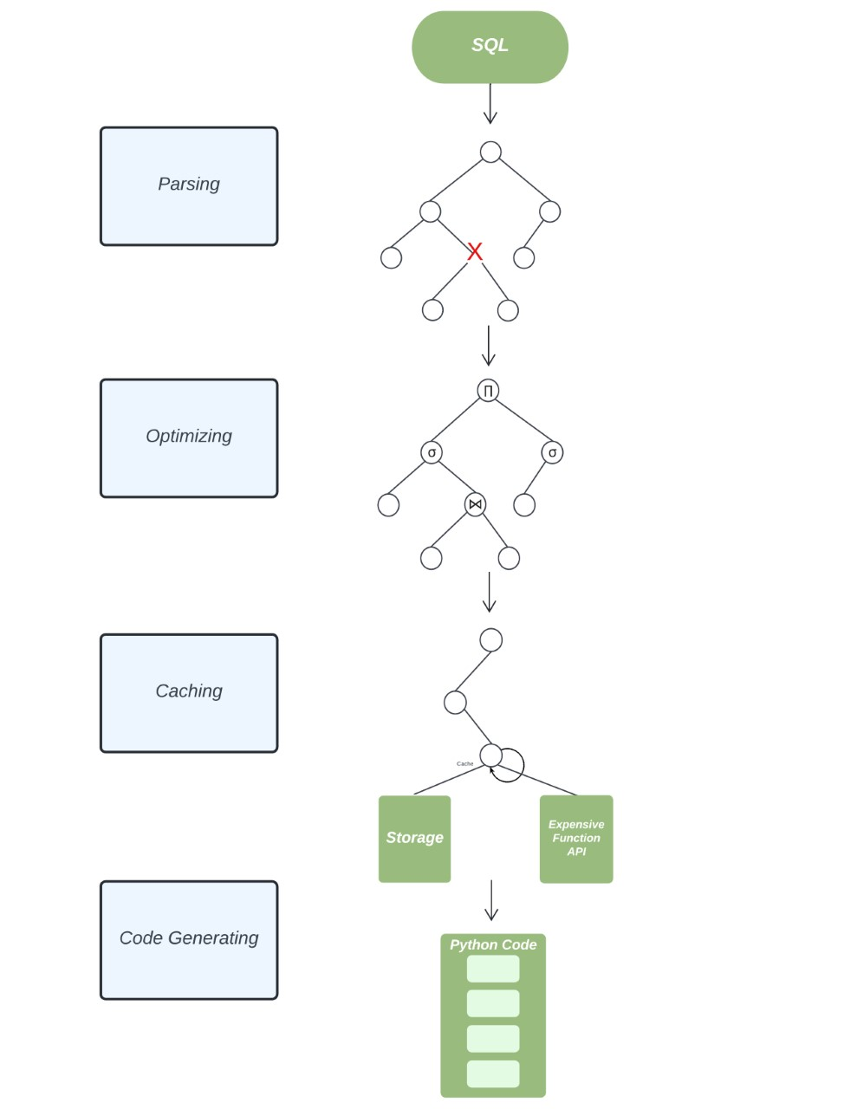
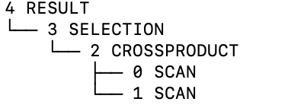
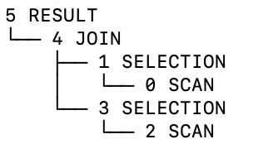
Towards a Declarative Support for Function APIs
Gustavo Frances, Mohammed Uwais
^{Mentor: Mohamed E. Khalefa}
SUNY Old Westbury, NY
j
k
There
Summary and Conclusions
The architecture of our proposed system consists of the following main components: 1) parser, 2) optimizer, 3) code generator, 4) executer, 5) Cache manager, and 6) API definitions: define function name, input parameters, output structure and if it can be cached, side effects, dependencies between functions.
Errors can be non-deterministic (may succeed if retried), or deterministic. Functions can be used as either: data sources (acting like a relational table) with no input parameters, or as a user defined function, processing input data.
We maintain call dependency: functions must be called in a specific order and result dependency: the output of a function is a superset of another. We assume flexible schemas, ignoring missing attributes and flattening nested structures.
When a user would type a SQL query, our framework would generate and execute an equivalent Python script. The parser would generate the query plan consisting of (a) traditional relational operators such as scan, join, and (b) API function calls. Based on our cost estimation and statistics (if any), we generate an optimized plan.
Then, the plan is extended to handle nondeterministic errors and amortize function initialization and model loading.
Finally, we convert this plan into a python script. Users can inspect generated scripts and modify them.
Introduction
Solution Overview
Results
With the widespread availability of data and API libraries for complex tasks such as image, natural language processing, it becomes feasible to build powerful applications.
While Python packages provide an extensive library for these APIs, manually writing these application workflows that consume and/or invoke is a cumbersome task.
This is mainly due to (1) the need to handle data with heterogeneous structures, (2) the tight coupling function calls provided by the APIs, including the API versions, parameter types, and error handling, and (3) user authentication, and call rate limits.
Optimizing such workflows is challenging, due to the arbitrary cost model and inconspicuous relations among these functions.
To this end, we are proposing a declarative approach to hide these details from users and allow for optimization and reduce redundant calls.
Describe all your study results and use statistics where applicable
Screenshot for Plan before optimization
Method
In order to implement and maintain a successful declarative language for APIs, we first need to consider the solution’s architecture. Our architecture would need to hide the details from users and allow for optimization and reduce redundant calls
We first start with a SQL query the user would type in order to retrieve the data.
Our parser will than create a query plan
Once the query plan is created, we will use relational algebra to advance the query plan. Traditional relational operators will be used such as scan, join, selection, projection, and API function calls.
Here we optimize the query plan based rules. We plan to incorporate cost estimation. We also implement our cache system, storage system, as well as handle nondeterministic errors and amortize function initialization and model loading.
Finally, the query plan is implemented in the backend using Python code which will be used to execute the query. Users will be able to inspect the generated scripts and modify them as they see fit.
This workflow allows us to successfully implement our solution architecture while achieving the goals we set out in our application domain. So far, we are supporting with three types of formats.: files, directory, and API. For files and directly the generated schema will hold information regarding the data field location, specifically for files we will add rows or columns. For directly we have row, column, and file name. For API we have information regarding user and endpoints.
Screenshot for Plan after optimization
Acknowledgements:
We would like to thank our professors at SUNY college at Old Westbury, and special thanks to Dr. Ebrahimi and Betty Berbari for making it possible for us to be here today.
Discussion
Our system allows us to implement a high-level language that allows
users to implement API calls without knowledge of what is being done
on the backend. Some ways we can improve on the system is by:
Improving the system to have faster performance
Further optimizing our query plans
Making our architecture extendible so updates are easily added.
Improving further on caches system as well as storage
Improving upon our failure/retry.
References:
Rompf, Tiark, and Nada Amin. "Functional pearl: a SQL to C compiler in 500 lines of code." Proceedings of the 20th ACM SIGPLAN International Conference on Functional Programming. 2015.
Tahboub, Ruby Y., Grégory M. Essertel, and Tiark Rompf. "How to architect a query compiler, revisited." Proceedings of the 2018 International Conference on Management of Data. 2018.
Scully, Ziv, and Adam Chlipala. "A program optimization for automatic database result caching." Proceedings of the 44th ACM SIGPLAN Symposium on Principles of Programming Languages. 2017..
Funding:
Project is partially funded by NSF CISE-MSI: AWARD #2131052

